Slide 1

How to run GitLab in a docker container
Subscribe my YouTube Channel
“SimplyLearn”

Slide 2
Pre-requisite Knowledge: Required: Basic understanding of Linux/Windows OS
Optional: Good to have knowledge in Docker
Learn Docker here: https://youtu.be/P2dJkslDXSk
(Learn Docker from scratch)

Slide 3
GitLab: GitLab is a web-based DevOps lifecycle tool that provides a Git-repository manager providing wiki, issue-tracking and CI/CD pipeline features. GitLab offers a location for online code storage and collaborative development of massive software projects. The repository includes version control to enable hosting different development chains and versions, allowing users to inspect previous code and roll back to it in the event of unforeseen problems.
Docker: Docker is a computer program that performs operating-system-level virtualization, it is also known as "containerization".

Slide 4
What we do during this session
Install Docker engine
Pull “GitLab” docker image from docker hub
Run “GitLab” docker container
Create a sample project in GitLab
Work with “git” command line
Take a backup of GitLab
Restore GitLab from the backup

Slide 5
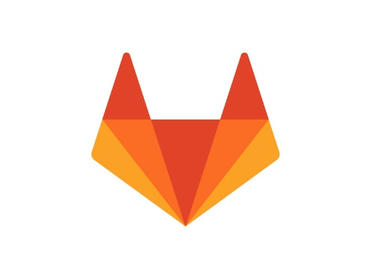

HOST01
GitLab
Access GitLab
Docker Engine

Slide 7
Thank you for watching…!!!
Please like this video and
Click the “Subscribe” button below

